Slide 1
フィリピン大学でスピーチすることに。次はあなただ！
３Q

Slide 2
自己紹介
名前: 山中 知也
居住地: フィリピン、マニラ
仕事： ITエンジニア
趣味: ITセミナー参加・開催
資格: Microsoft Certified Trainer(MCT)など
役割: YASC, INC 創始者
わんくま同盟@マニラ・ディレクター

Slide 3
カレッジでセミナー
これまでのマニラでの草の根セミナー普及活動（セミナーは良いぞ～、やらないなんて人生損してるぞ～、等と耳元で）が実り、
先々週と先週にマニラのカレッジに呼ばれて、
Microsoft Azureの紹介セミナーしてきました。
その様子をご報告させてください。

Slide 4
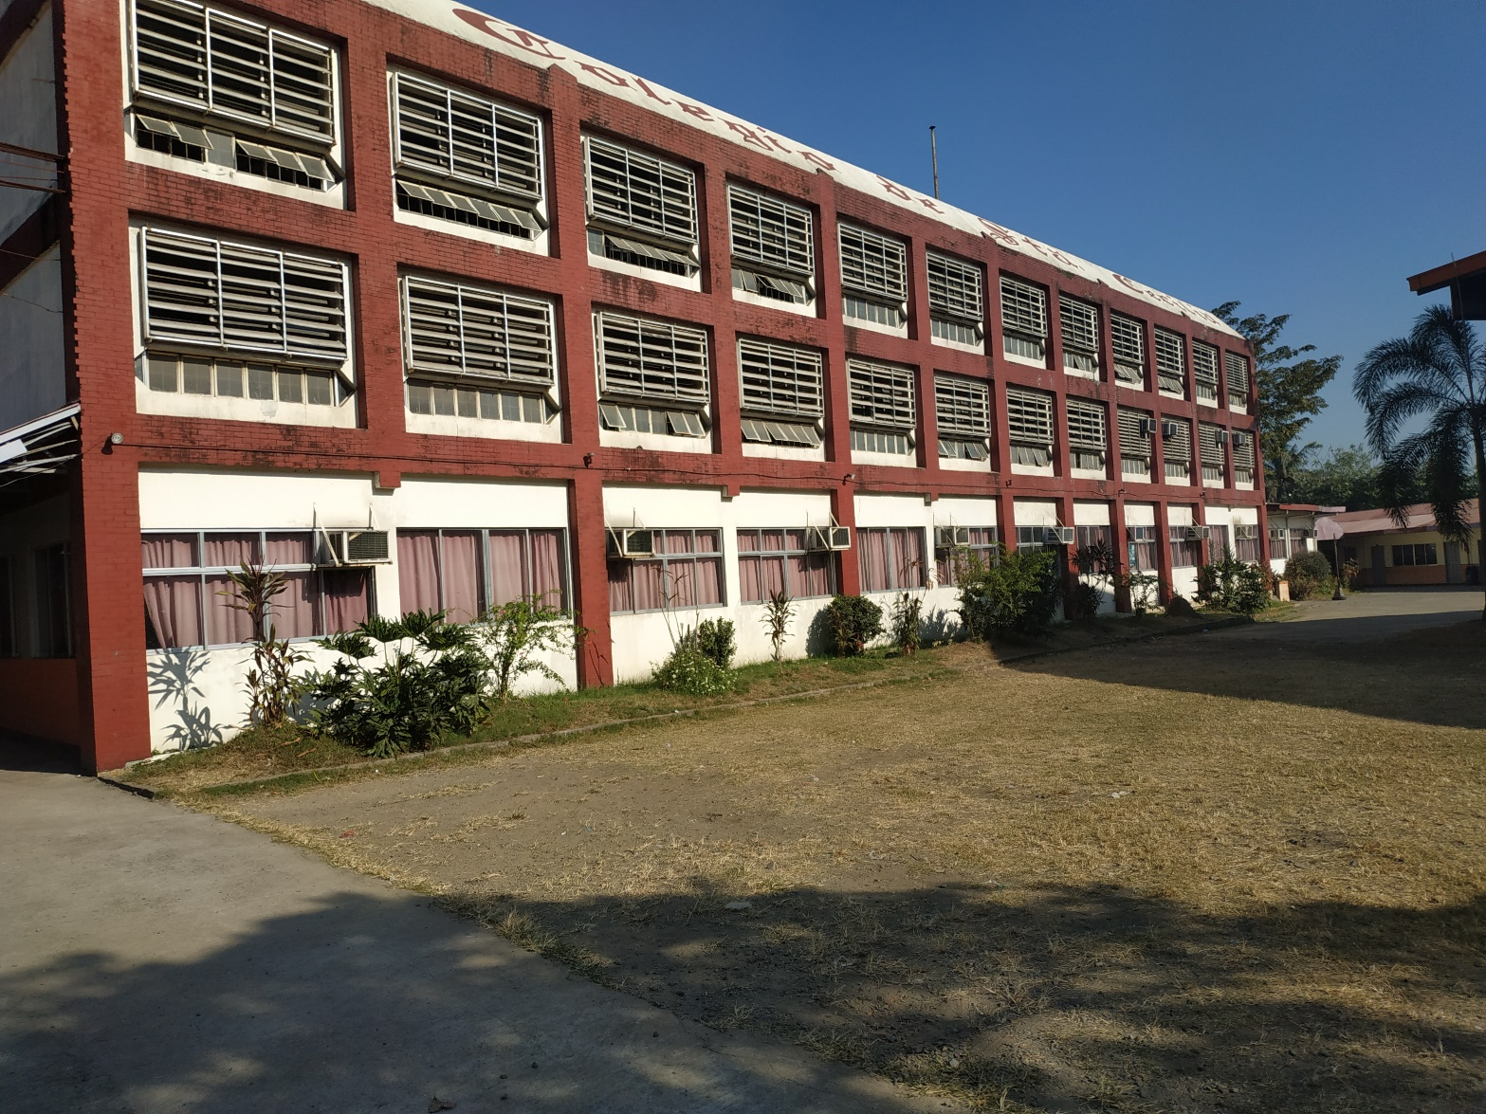
カレッジでセミナー

Slide 5
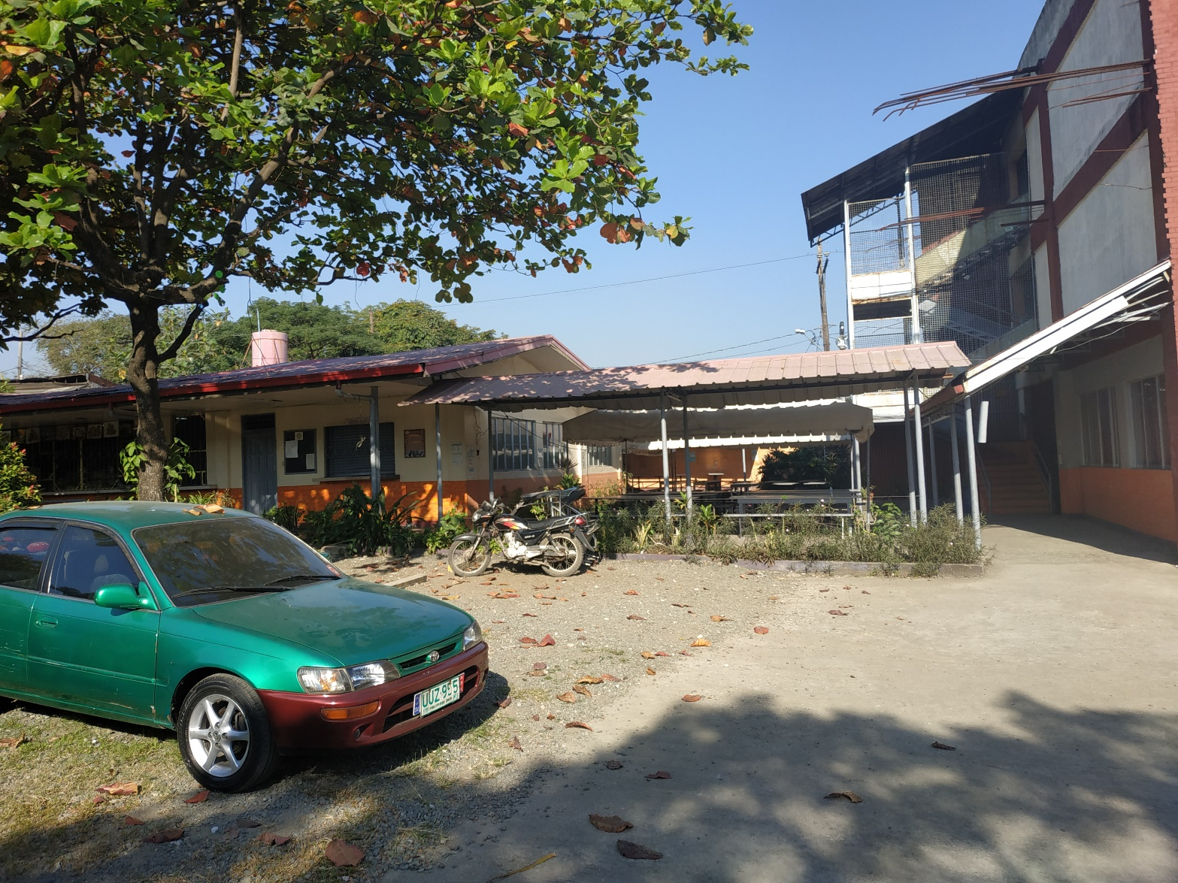
カレッジでセミナー

Slide 6
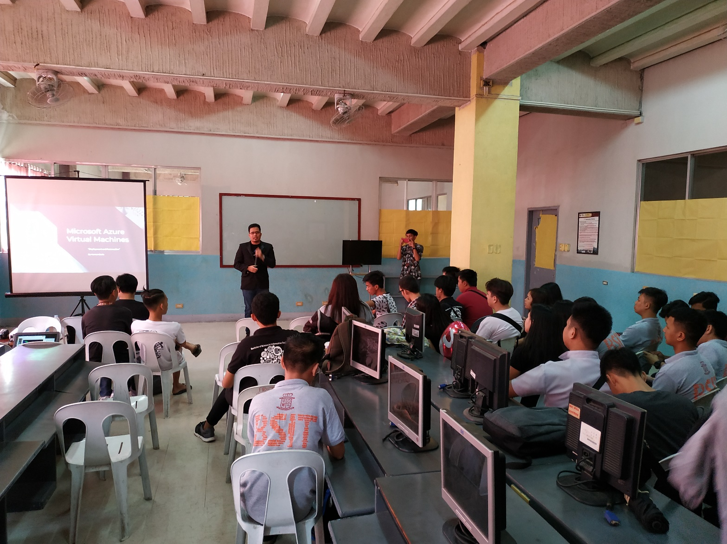
カレッジでセミナー

Slide 7
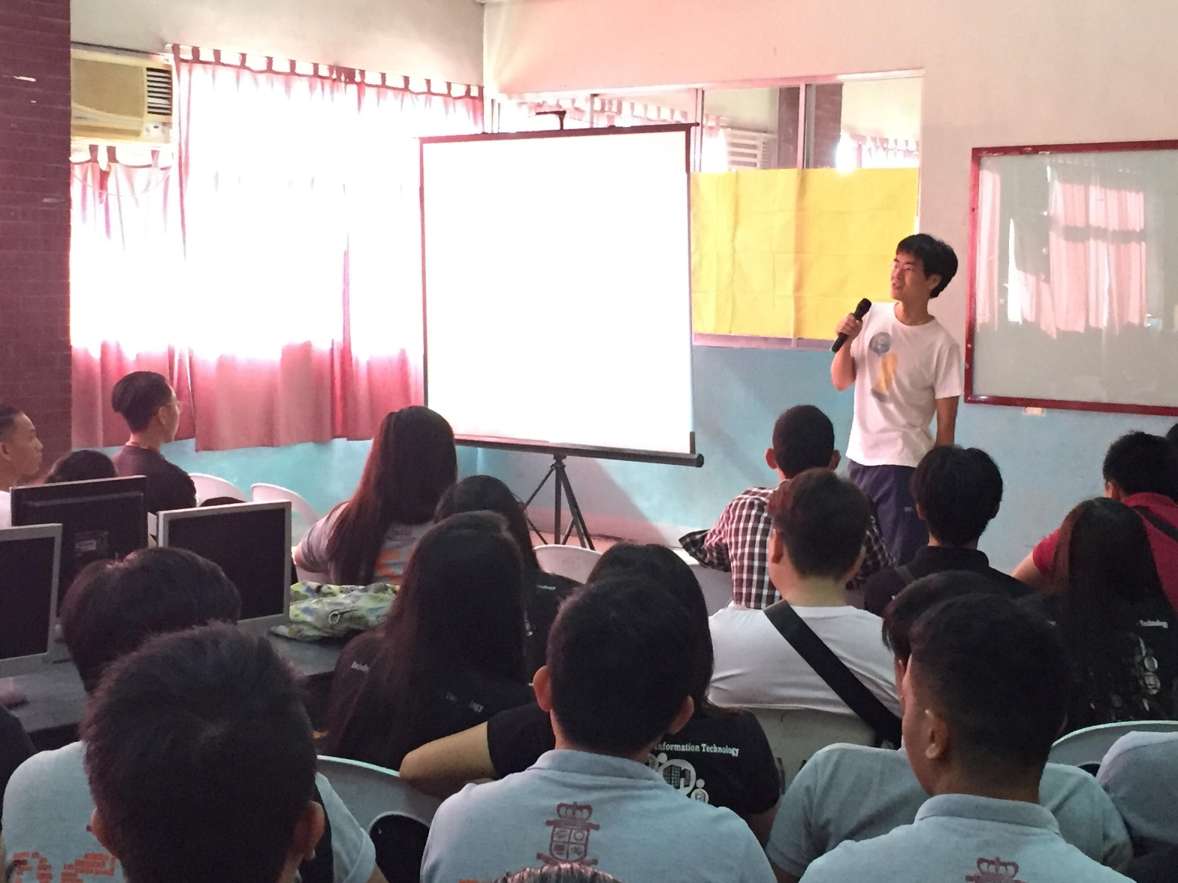
カレッジでセミナー

Slide 8
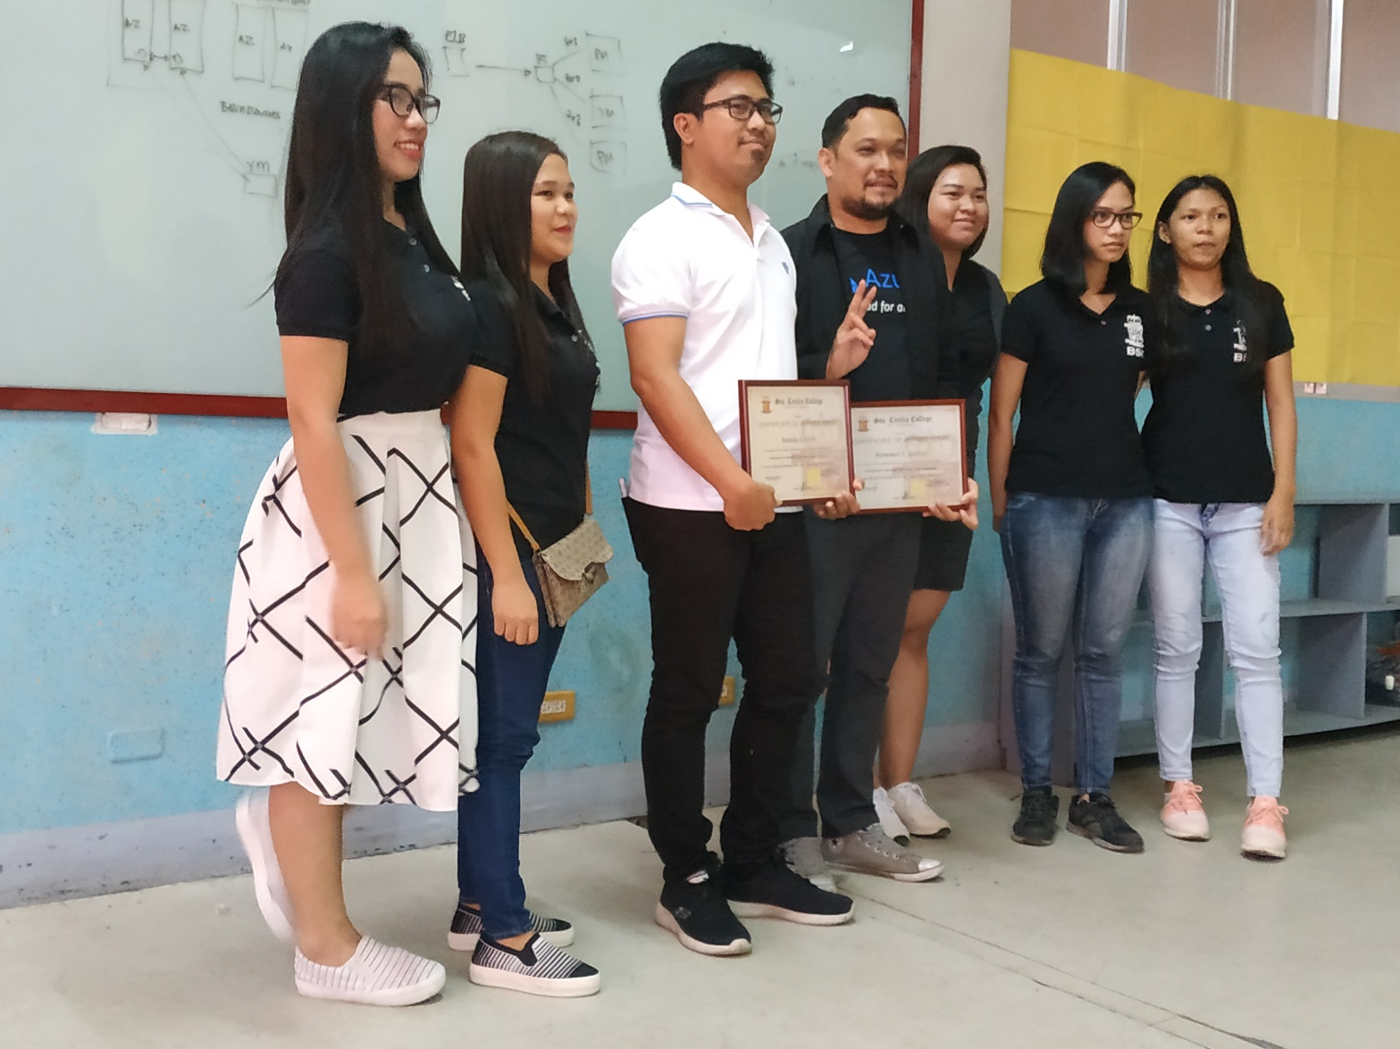
カレッジでセミナー

Slide 9
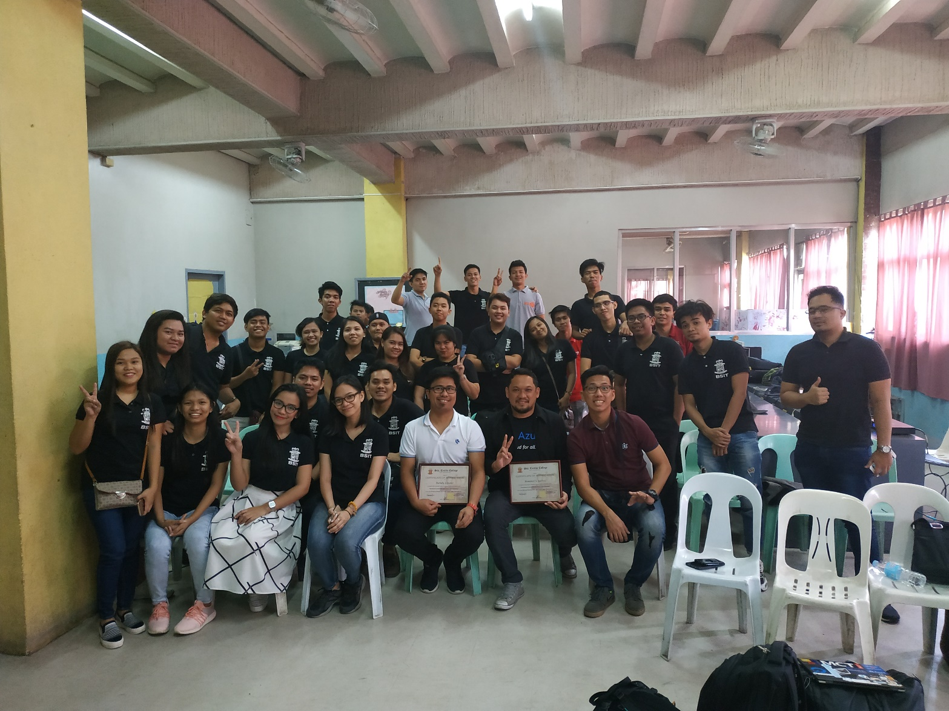
カレッジでセミナー

Slide 10
ここからは当時使ったスライドを さらっと見つつその時にあった 反応のトークを。。。

Slide 11
Microsoft Azure Cloud Usage

Slide 12
Agenda
Introduction of myself, and our group Wankuma Alliance
Review of what “cloud” is.
Why I chose Azure as my topic.
How Azure is actually used in business; Example of my previous work.

Slide 13
INTRODUCTION

Slide 14
Self Introduction
Name: Tomoya Yamanaka
Nationality : Japan
Language: Japanese, English… and a little Chinese and Tagalog
Hobby: Attending/Doing Free IT Seminar
Work: IT Consultant
Certification: Microsoft Certified Trainer
Position: Founder of YASC, INC
Wankuma Alliance Manila director

Slide 15
About Wankuma Alliance
Wankuma Alliance is a Japanese free IT seminar group which have already held over 200 seminars in more than 10 years.
Home Page(Japanese):
http://wankuma.com/
YouTube:
https://www.youtube.com/channel/UC_6s2HNcKjray21gTKVCYQw
Facebook(Philippines):
https://www.facebook.com/groups/WankumaAlliancePh/

Slide 16

About Wankuma
Wan-わん- is “bowwow” by dog in Japanese.
Kuma-くま- is “bear” in Japanese.
The 2 founder of Wankuma Alliance named it with almost joking, but the activity became quite long

Slide 17
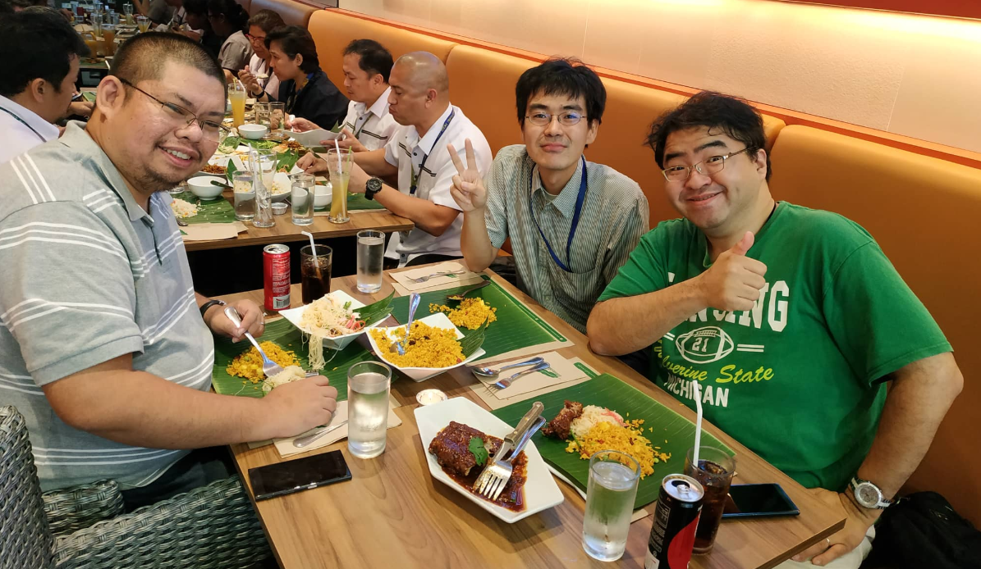
The founder of Wankuma Alliance
Founder:
Hirotoshi Naka
Big Man!

Slide 18
If you prefer Filipino group
There are many other IT groups now a days.
Following group PHINUG is my recommendation.
PHINUG(PHilippines .Net User Group) Facebook:
https://www.facebook.com/groups/phinug/
Organizer:
Jon
Limjap
Nice Guy!

Slide 19
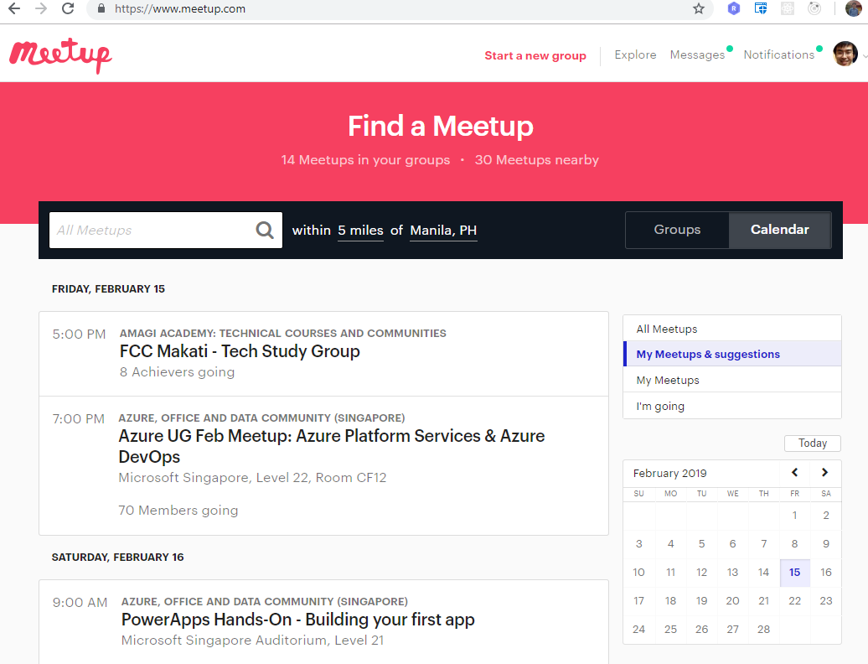
If you prefer Filipino group
You can find other groups with
https://www.meetup.com/

Slide 20
Any question so far?
Is there someone who wants to take a picture of a previous page?

Slide 21
Review About cloud

Slide 22
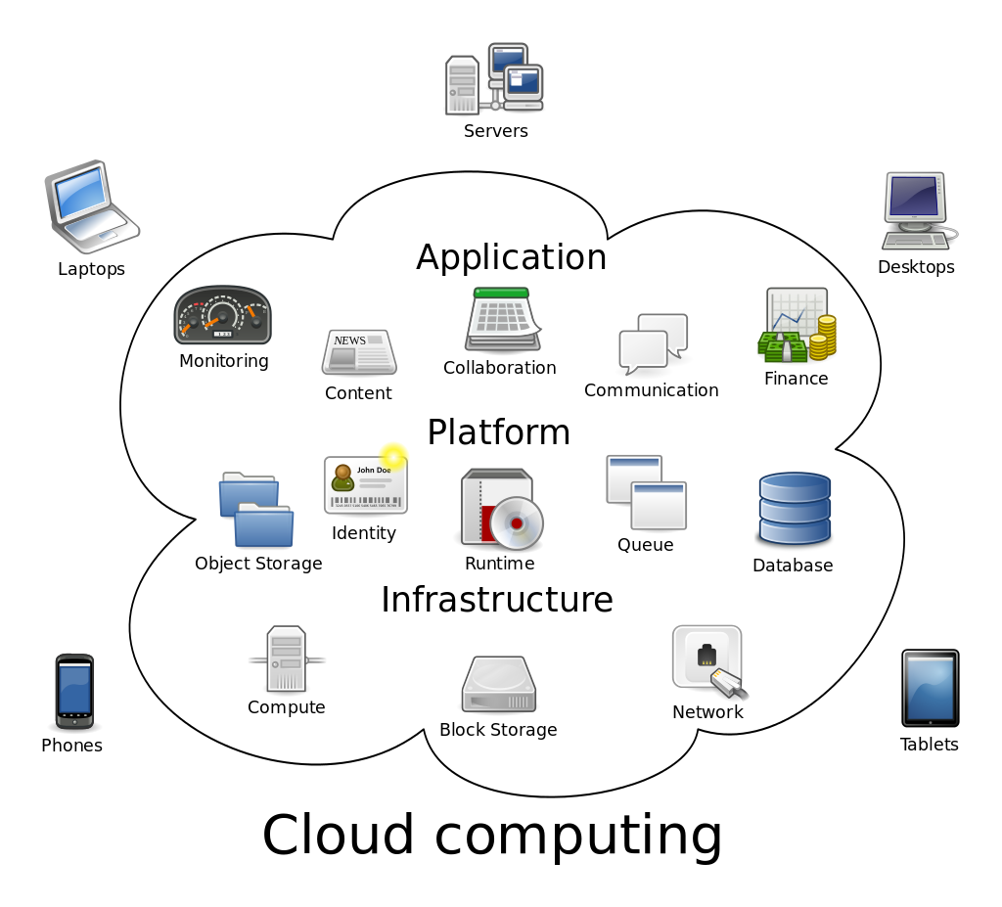
What’s Cloud?
My rough explanation:
Data center rental server services nowadays.
Opposite word is On-Premise (local machines).
https://en.wikipedia.org/wiki/Cloud_computing

Slide 23
What case Cloud is good?
It’s especially good for testing purposes
We can do quick start and quick bye-bye
I have new idea.
I wanna try
On-Premise:
Need to buy machines
Need to place the machines.
and so on…
Time consuming and costing!
Cloud:
Need an cloud account
Need to apply some operation on cloud portal or console
Done!
Much faster than on premise and easy to delete also.

Slide 24
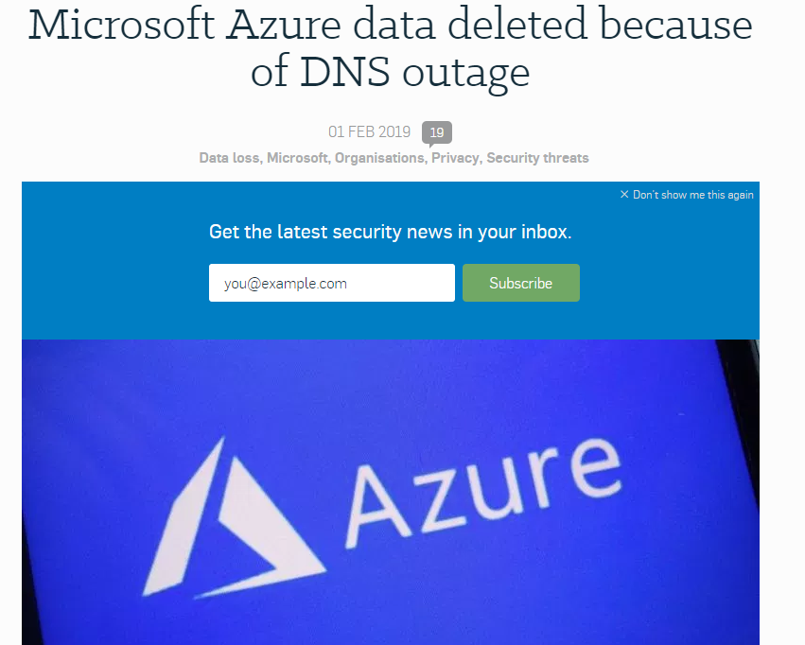
Should we use Cloud all time?
Cloud is a data center service so that if you don’t want data center trouble, you should still use On-Premise machines.
https://nakedsecurity.sophos.com/2019/02/01/dns-outage-turns-tables-on-azure-database-users/

Slide 25
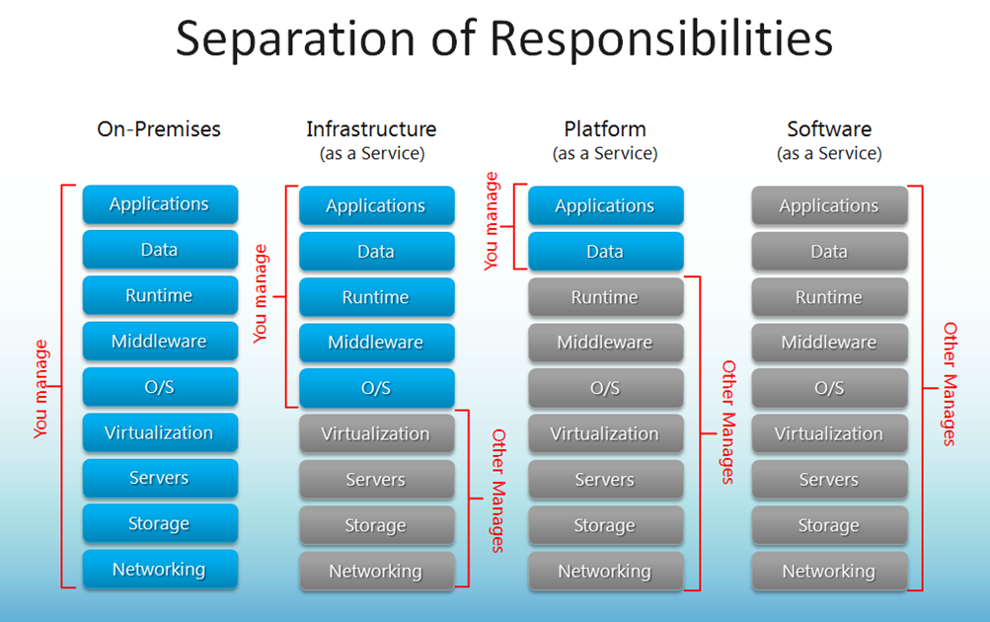
Should we use Cloud all time?
https://blogs.technet.microsoft.com/kevinremde/2011/04/03/saas-paas-and-iaas-oh-my-cloudy-april-part-3/

Slide 26
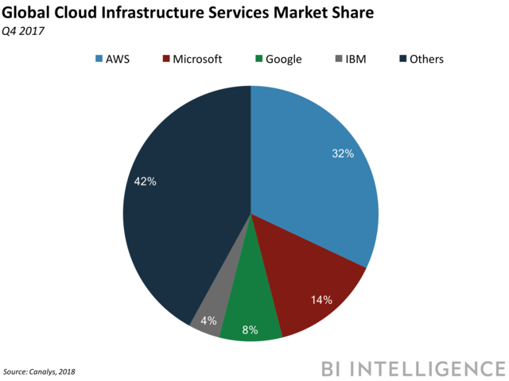
What are the Major Cloud?
AWS by Amazon
Azure by Microsoft
Google Cloud
by Google
And so on…
※AWS is the most popular because it’s the world first cloud
and the service price is cheapest in most cases.
https://www.businessinsider.com/global-cloud-market-q4-2018-2

Slide 27
That’s all from me for reviewing cloud knowledge.
Is there someone who wants to add more?

Slide 28
WHY Azure?

Slide 29
Why Azure?
-Azure is No.2 share cloud provided by Microsoft.
(Good Position)
-Because of Microsoft, there are lots of …
Documents, especially for developers.
Relatively reasonable service fee for MS products, such as Windows Server.
Dev Tool Supports, such as Visual Studio
Big Community and User Supports
※Microsoft Certified Trainer has provided subscriptions

Slide 30
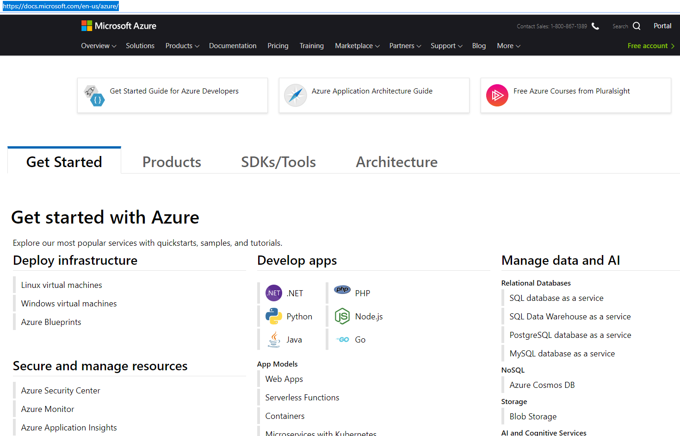
About Azure Documents
https://docs.microsoft.com/en-us/azure/

Slide 31
About Azure Documents
This is my favorite
https://docs.microsoft.com/en-us/azure/

Slide 32
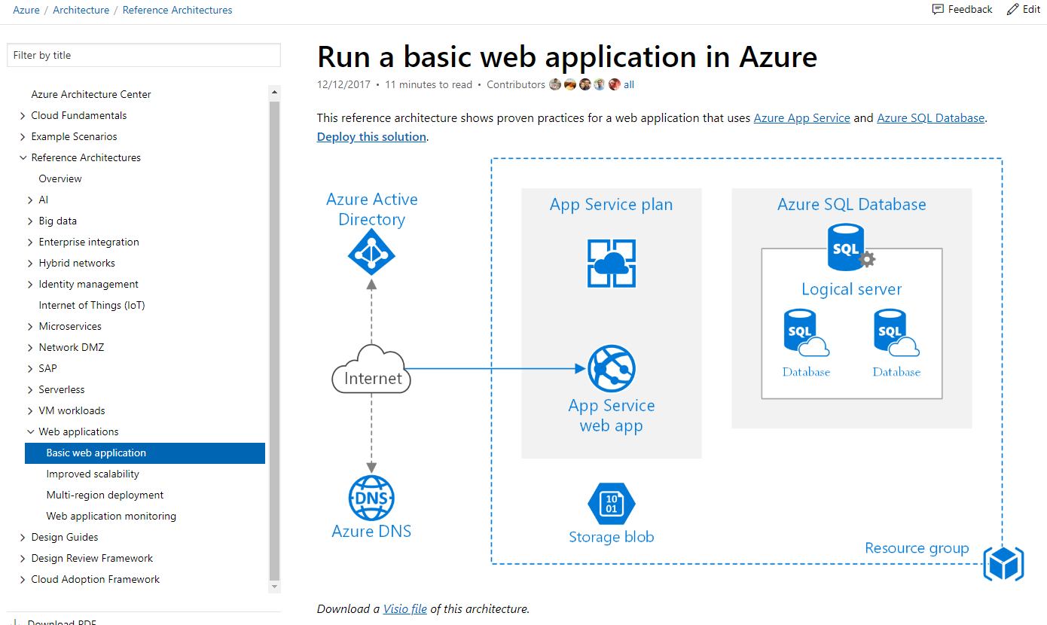
About Azure Documents: Web App Ref. Architecture
https://docs.microsoft.com/en-us/azure/architecture/reference-architectures/app-service-web-app/basic-web-app

Slide 33
Microservices
Lots of cloud services are made and connected to each other. This style design is called as Microservices.
It’s current trend of cloud.
https://docs.microsoft.com/en-us/azure/architecture/reference-architectures/app-service-web-app/basic-web-app

Slide 34
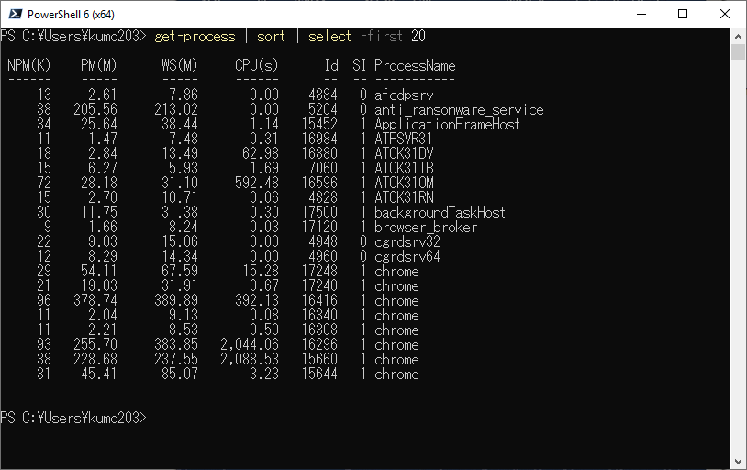
Microservices
The idea is same as command line piping.
1st cmdlet get-process’s output is piped to 2nd cmdlet sort and its output is piped to 3rd cmdlet select.
And then the result is the output.

Slide 35
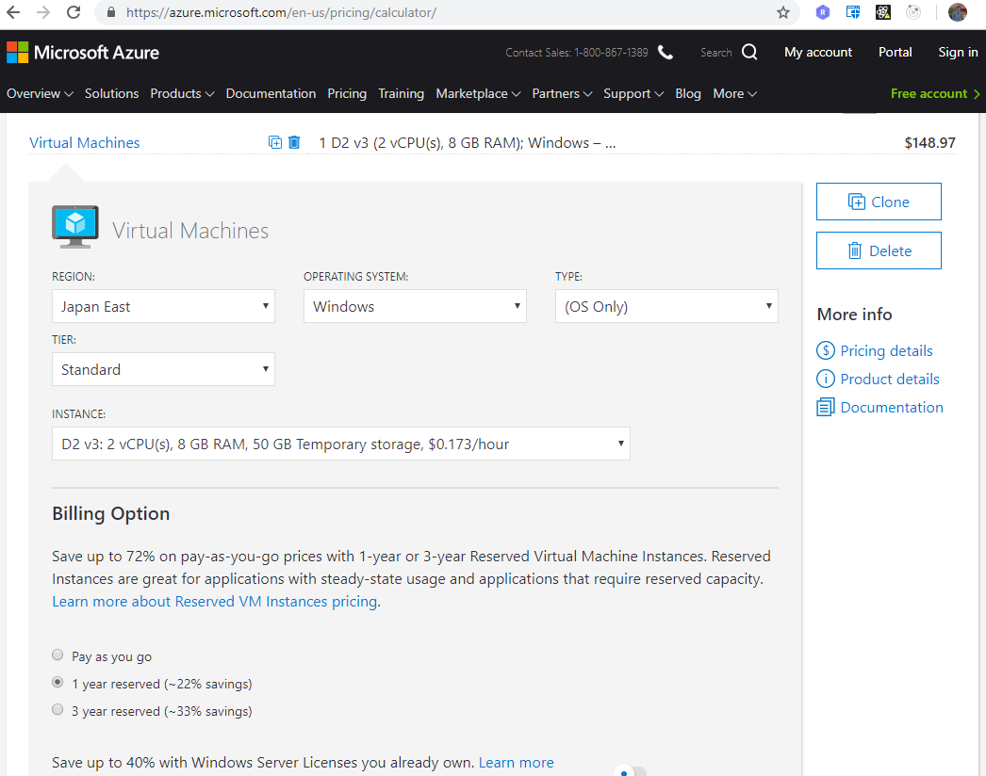
About Azure Price
https://azure.microsoft.com/en-us/pricing/calculator/

Slide 36
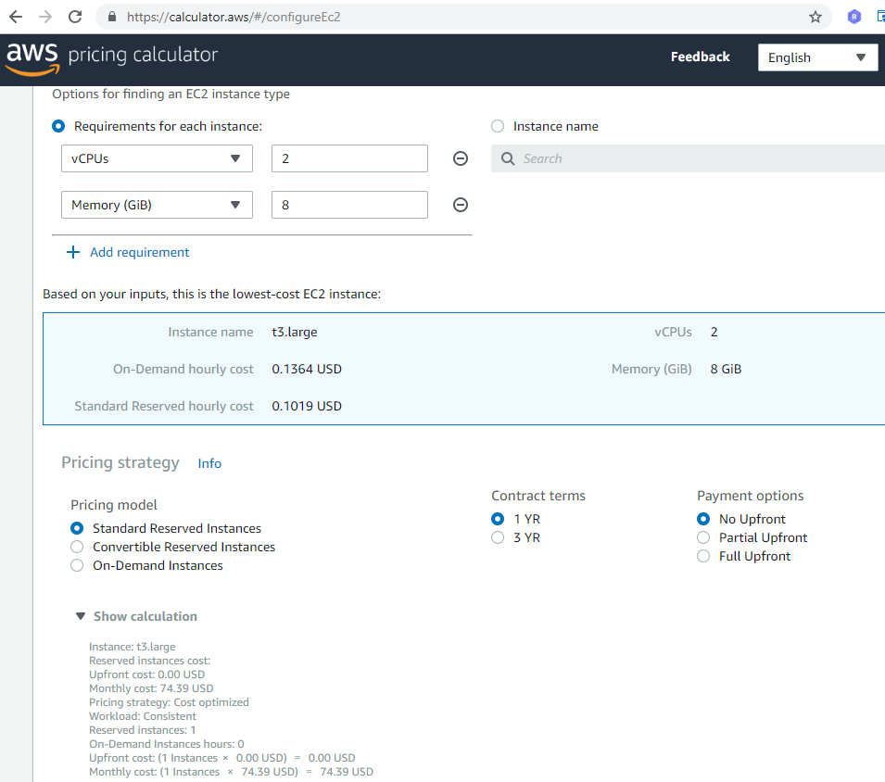
About AWS Price
https://calculator.aws

Slide 37
Azure Price vs. AWS Price
Azure(Japan East) Example:
AWS(Japan East) Example:
VM(2CPU8GB) $126.57
Storage(SSD) $ 22.40
☆Sub-Total $148.97
VM(2CPU8GB) $74.39
Storage(SSD) $ 3.60
☆Sub-Total $77.99

Slide 38
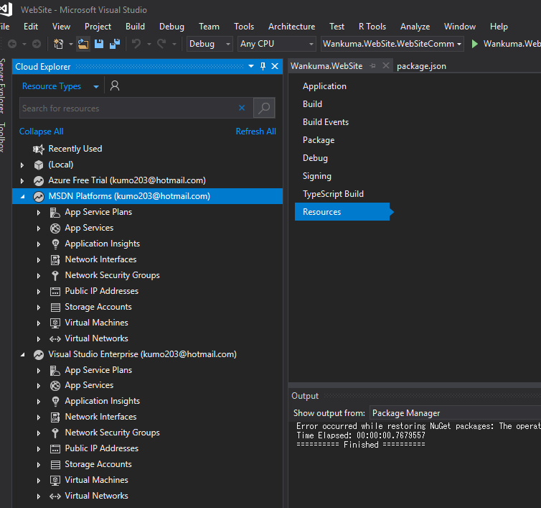
Visual Studio Support
The most popular IDE Visual Studio provides its default integrated Azure support.

Slide 39
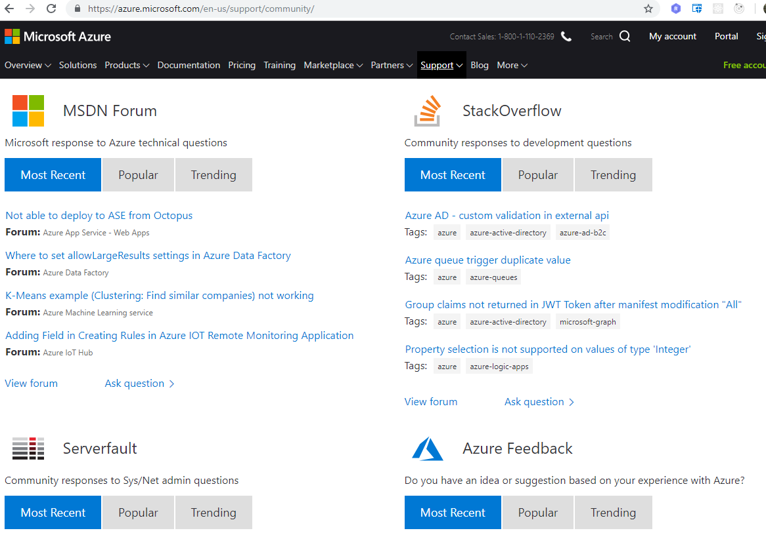
Community Support
https://azure.microsoft.com/en-us/support/community/

Slide 40
Those are the reasons why I like Azure.
At least it’s good one in many.

Slide 41
Example in actual business

Slide 42
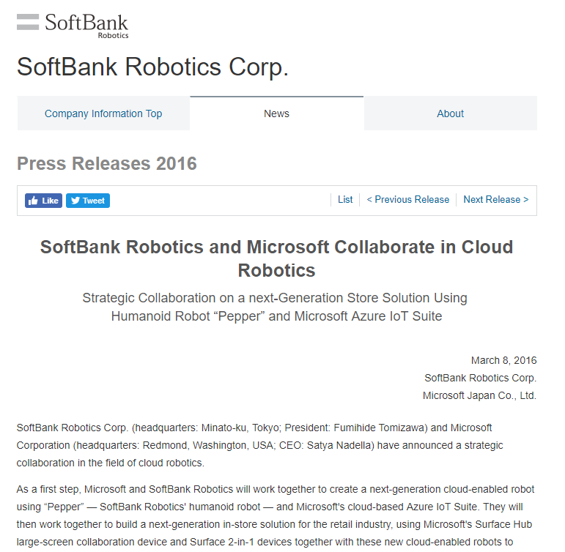
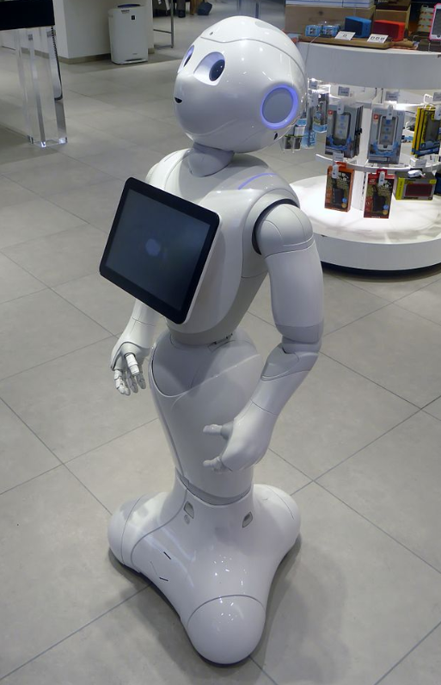
IoT data collecting system with Azure
https://www.softbank.jp/en/corp/group/sbr/news/press/2016/20160308_01/
https://en.wikipedia.org/wiki/Pepper_(robot)

Slide 43
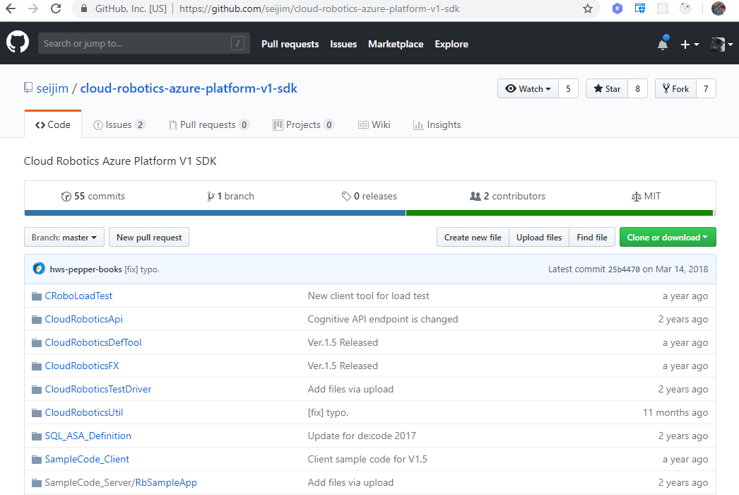
Cloud Robotics Azure Platform
https://github.com/seijim/cloud-robotics-azure-platform-v1-sdk

Slide 44
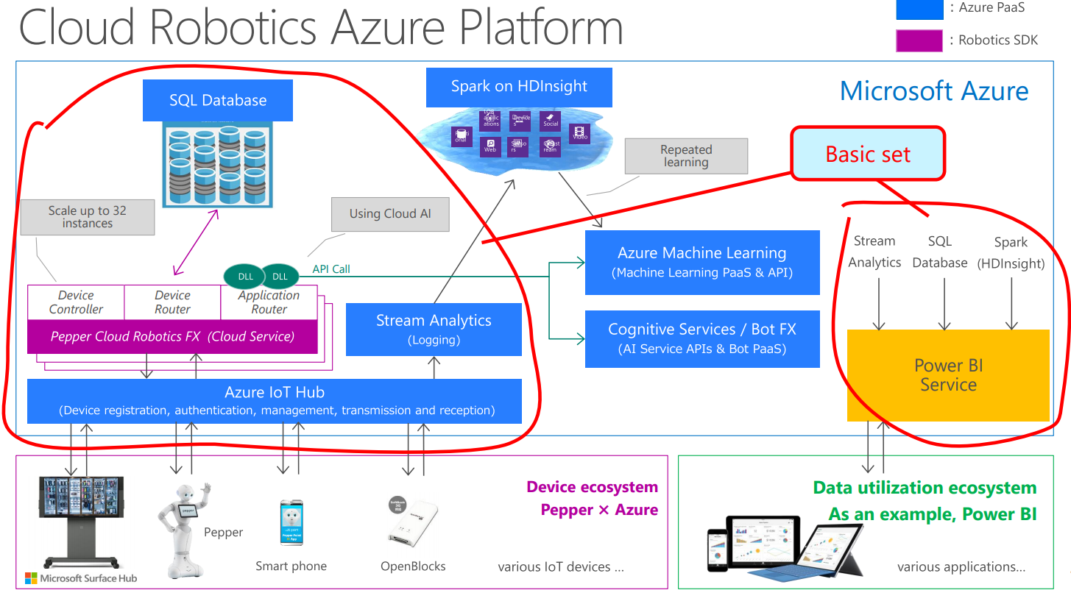
Cloud Robotics Azure Platform
https://github.com/seijim/cloud-robotics-azure-platform-v1-sdk

Slide 45
Cloud Robotics Azure Platform
Microservices architecture to compose the service.
https://github.com/seijim/cloud-robotics-azure-platform-v1-sdk

Slide 46
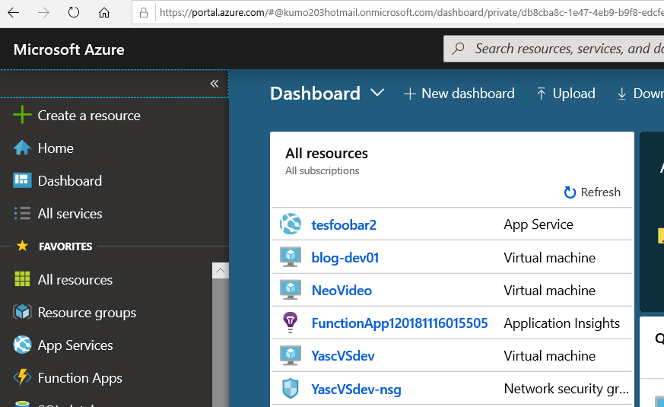
Normal Way: Azure Portal
Because of Microservices architecture, the system has lots of services. It takes time make the services in Azure normal way, Azure Portal.
https://portal.azure.com/

Slide 47
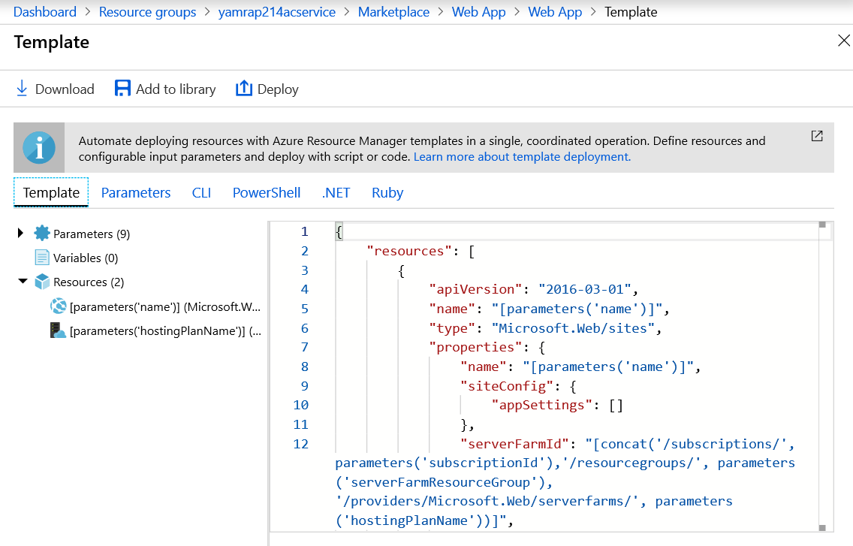
Batch Way
For such case, there are ways to make services from scripts, such as Powershell, Ruby and so on.

Slide 48
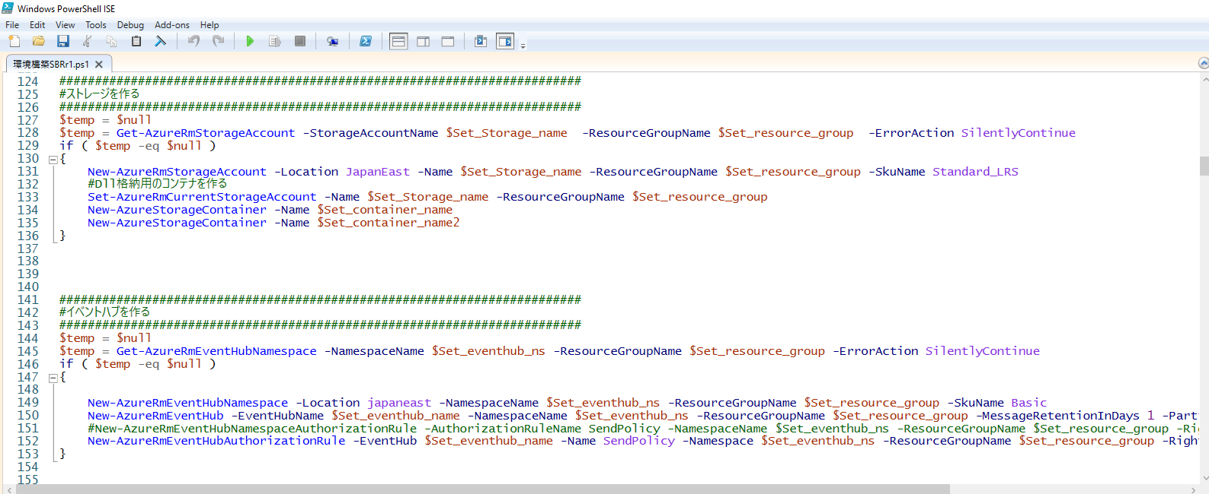
Batch Way:Azure Powershell
We used Powershell for our project.

Slide 49
That’s the actual usage we did in our business project.
Any question about it?

Slide 50
Conclusion
Today, I explained about Azure.
Azure is one example of cloud, and cloud is one field, where the innovations are happening most often.
When you use it, you need to keep tracking its updates.
Thus, Good Luck!!

Slide 51
以上です。 次の機会は一緒に行きましょう！

Slide 52
おまけ フィリピンでのITビジネスについて
３Q

Slide 53
フィリピンITビジネス（人）
求人状況： C#プログラマー(PG)を募集すると１００人ほど応募がある。
給料： 新卒PGで大体５万円/人月
２～３年中堅で大体１０万円/人月
人の傾向： ・マニラでは英語は全員話せる（地方人だと危うい人も・・）
大学卒でも日本人より幼くて新卒はビジネスマナーからの
教育が必要。
・仕事の動きは縦割り意識が強くPGはコード書いたら終了
・残りはテスターの仕事と考えデバッグがいい加減気味等
少々困った考え方（日本人が世界的に特殊なのだが・・）
・プライドが高いのでみんなの前で一人を叱るなどはNG
（個室に連れて行ってそこで叱るべしという暗黙ルール有。
そのせいで同じことを何回もすることに・・）

Slide 54
フィリピンITビジネス（会社手続き）
会社登記など： 政府関係の手続きはお役所仕事で予定より遅れがち。
最短３か月程度で良いエージェントに任せると一通り
終わるが最長１年程度グダグダとかかることも・・。
（役所が提出した書類をなくしてやり直しなどで・・）
費用： 会社の種類（何もなし、PEZA、CEZA等）によって色々。
PEZAでやったときは一式１００万円で余りがでました。

Slide 55
以 上

